Slide 1

Plan Your Date Night
Michael Arvelo
Delaney Charney
Jared Davis
Ronan Galvez

Slide 3

Concept
Description
Motivation for development?
User story

Slide 4
Process
Technologies used
Breakdown of tasks and roles
Challenges
Successes

Slide 5
Demo

Slide 6

Directions for Future Development

Slide 7
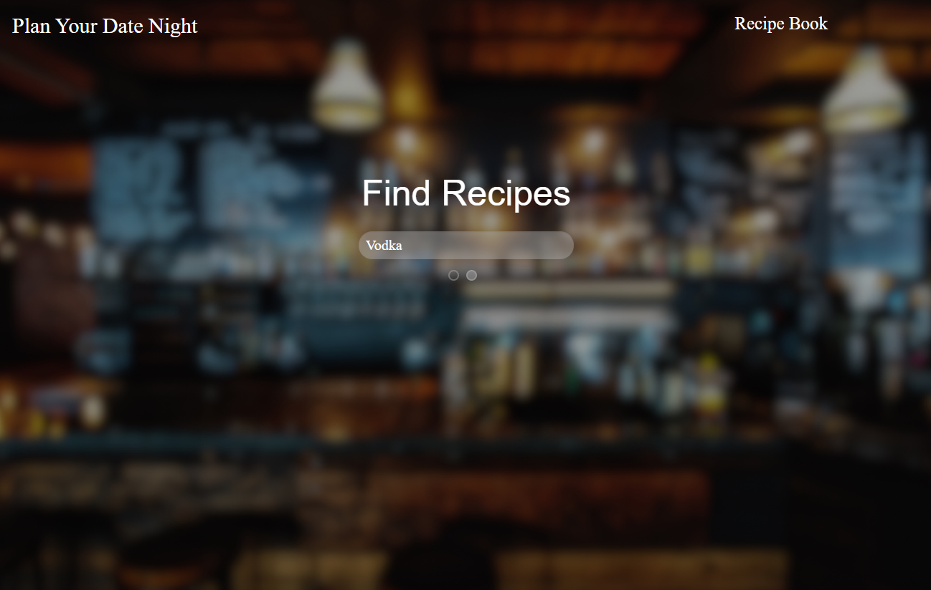
Links
Deployed: https://MichaelDevelopsCode.github.io/plan-your-date-night/
GitHub repo: https://github.com/MichaelDevelopsCode/plan-your-date-night

